Slide 1

Today we celebrated World Book Day!
The children started their day with a special assembly with Mrs Smith. She had new books for every class but had lost them! We needed the children’s help to locate the missing books!

Slide 2
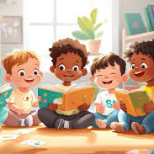
The children visited every teacher!
Every teacher read them a special story. They then had to solve a puzzle based on the story.
After completing the puzzle, the teacher rewarded them with a co-ordinate.

Slide 3
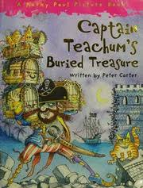
Miss Caddell read Captain Teachum’s Buried Treasure!
Then they had to find where Miss Caddell chose to bury her hidden treasure! If they found the right location, they discovered the co-ordinate!

Slide 4
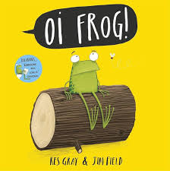
Mrs Rogers read Oi Frog!
Then they had to match the rhyming pictures. If they found the odd one out, they were given the coordinate!

Slide 5
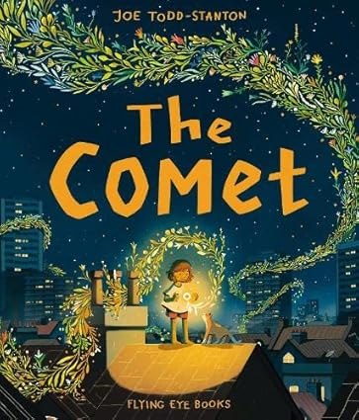
Miss Welsh read The Comet
The children had to search a picture of the night sky and spot the coordinate in the stars.

Slide 6
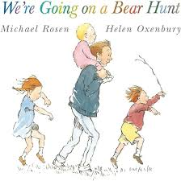
Miss Burt read We’re going on a bear hunt.
The children went on a bear hunt to find the bear that had their co-ordinate.

Slide 7

Mrs Arnold read Pirates Love Underpants
The children had to search the pirate ship to find pants. They sorted the pants into matching pairs to find the odd one out. This led them to the pirate flag with the correct coordinate.

Slide 8
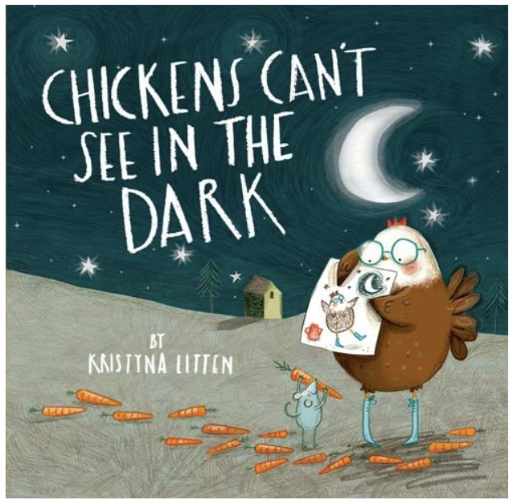
Mrs Barber read
Chickens can’t see in the dark.
Then they had to find all the carrots in a picture of Sunnyside farmyard. If they found all of the carrots they were given the coordinate!

Slide 9
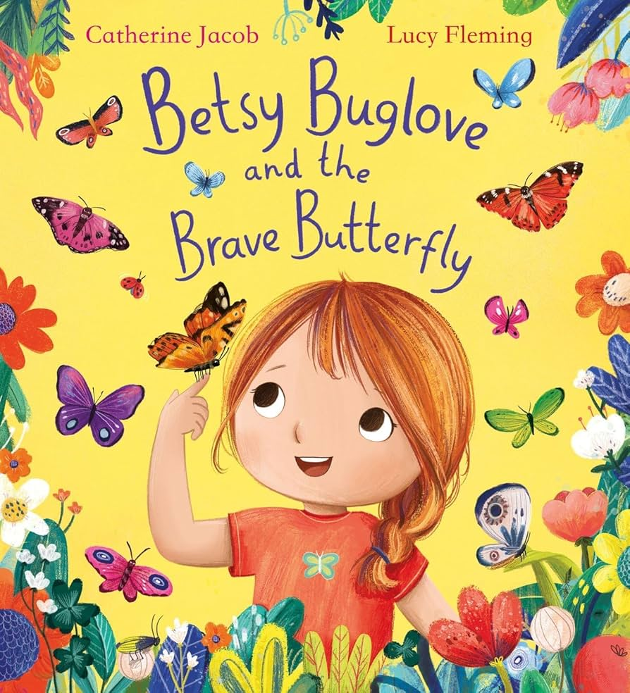
Mrs Street read Betsy Buglove and the Brave Butterfly.
The children had to use the magnifying glass to check which butterflies were symmetrical. The butterfly with different wings had the correct coordinate on the back.

Slide 10
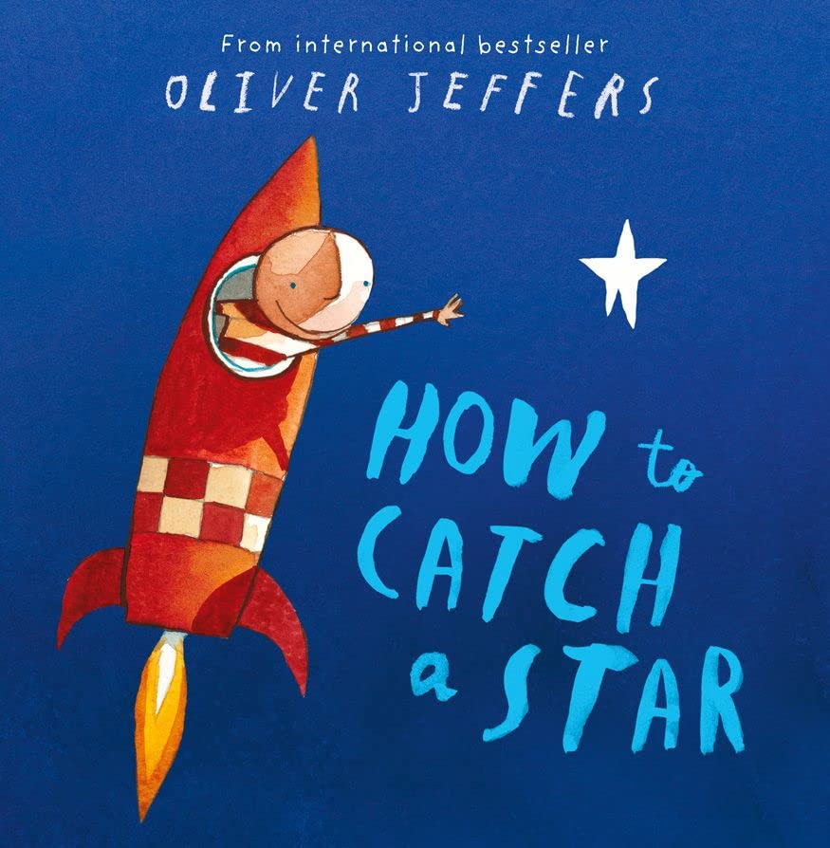
Miss Fox read How To Catch a Star.
The children used torches to find the words hidden in the stars. One word on their sheet was not found within the stars and this revealed the next clue.

Slide 11


At the end of the day, we went back to the hall.
We played Battleships. For every correct coordinate, we were given a word. It revealed that the books were hidden in the train!

