Slide 1




Welcome to Reception

Slide 2
EYFS
Nursery to Reception
Reception is the next developmental stage of learning following on from Nursery.
We continue to focus on all 7 areas of the EYFS curriculum.
Greater emphasis is given to Literacy and Maths as we follow the guidance, ‘Bold Beginnings’.
There is great emphasis on learning through play and exploration both inside and outside the classroom.
In Reception, we encourage children to develop their independence through the ‘Characteristics of Effective Learning’.

Slide 3
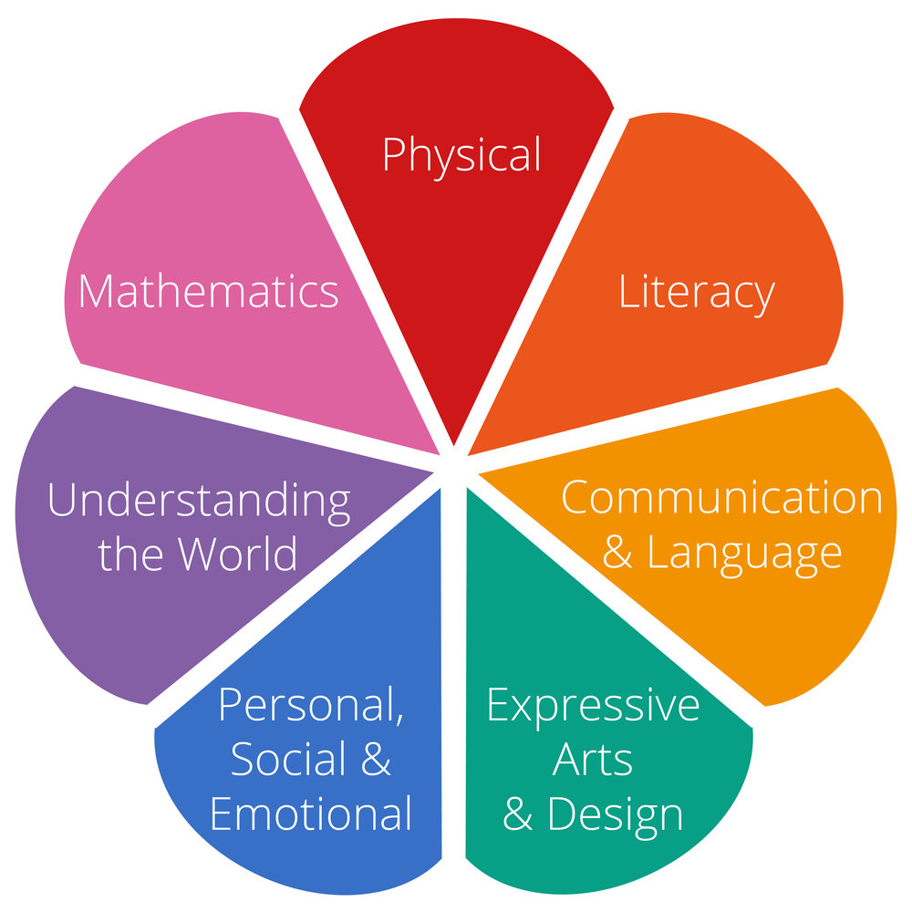
The EYFS areas of learning are:

Slide 4
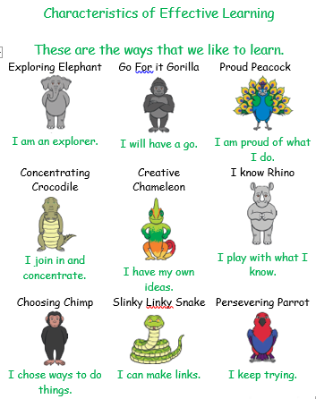
These show different ways of learning and are used to promote growth mindset.

Slide 5
A Typical Day in Reception Will Include:
Fine motor activities
Whole class input
Literacy
Choosing activities
Read Write Inc.
Playtime and fruit
Maths
Lunch time
Registers
Input from another area of the curriculum
Child initiated learning
Story
Home time

Slide 6
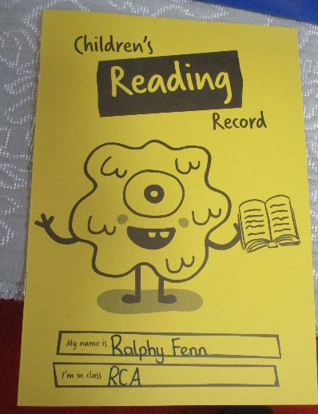
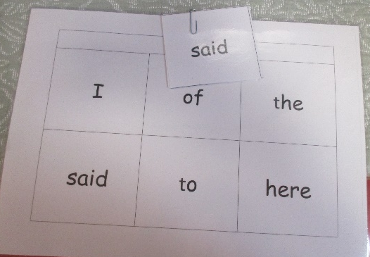
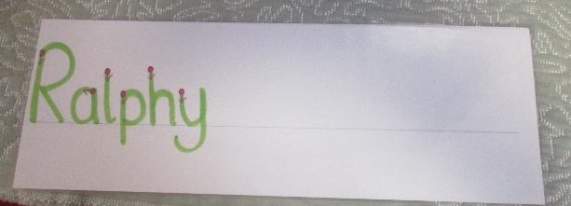
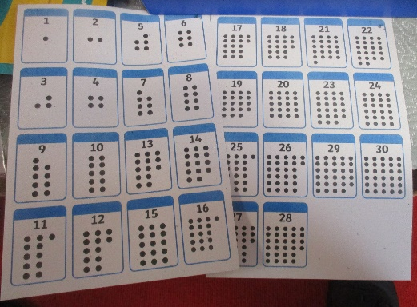
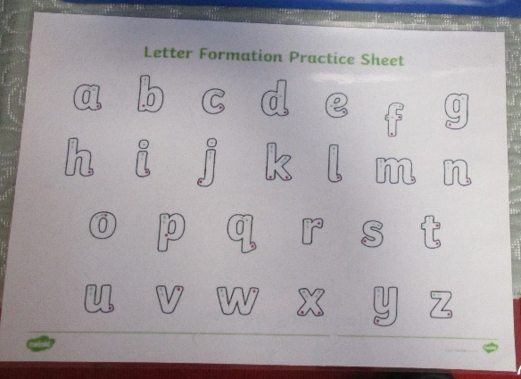
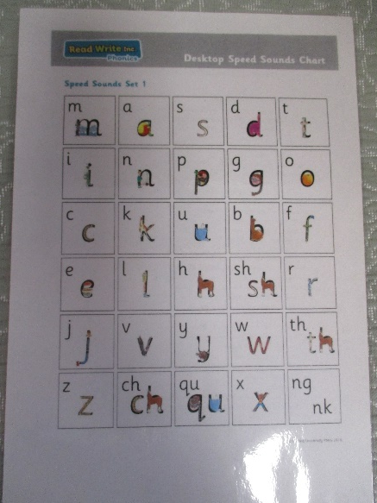
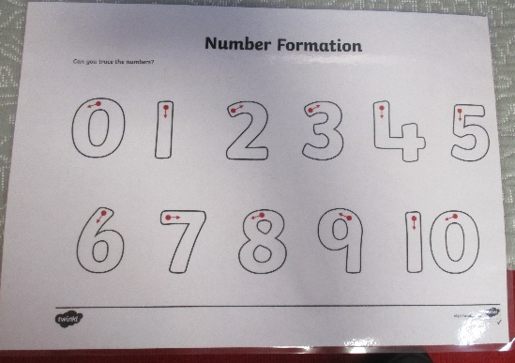
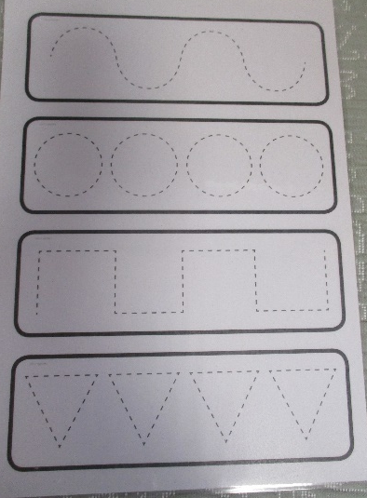
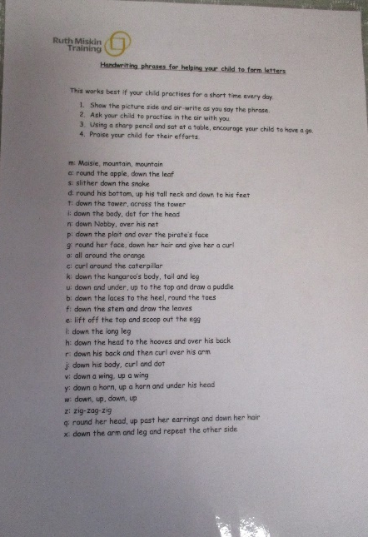
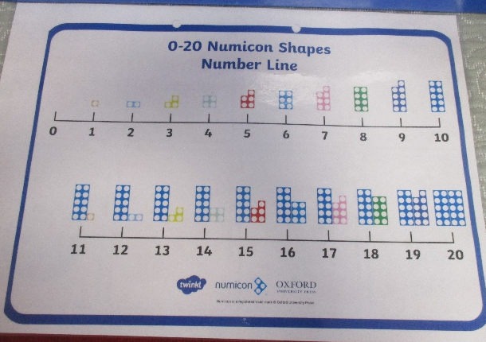
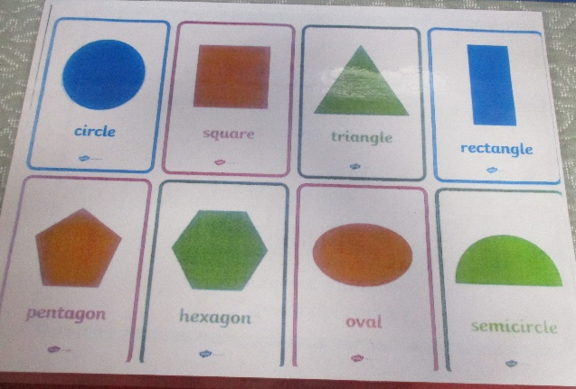
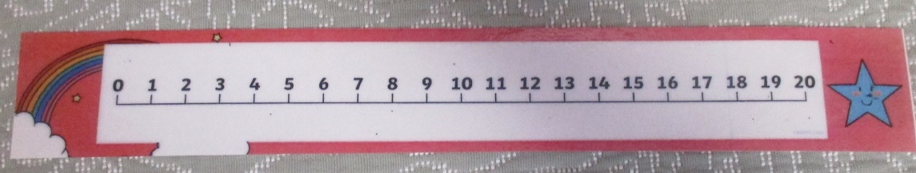
In your child’s book bag
Please check your child’s book bag regularly.
Please remember to label all of your child’s clothing

Slide 7

Achievements outside of school
We know your children do a lot of wonderful things outside of school and we would love to be able to share these within school.
When your child does something that you feel should be celebrated, please send these achievements to our Reception email address.
Examples of these shareable moments could be, your child rode their bike without stabilisers, they joined a club, or they ate a new vegetable.
Please feel free to send us photos etc. to share too!

Slide 8
Homework
Read with an adult at home 3 times a week.
Practise Group words once a week.
Creative homework once a week.

Slide 9
Learning to read and write
How will my child be taught to read?
In school, we follow Read Write Inc. There are some videos to explain this in more detail, available by searching Read Write Inc online:
What is phonics?
Sound pronunciation.
How to blend sounds to read words.

Slide 10
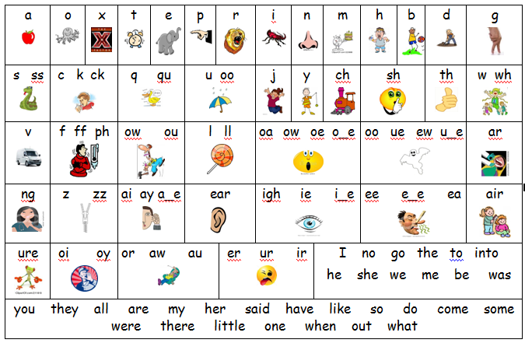

Slide 11
Group Words
Within Read, Write Inc. there are words known as Red words. These are the words which, for the majority, cannot be built up using sounds, so children are taught ‘You can’t Fred a red!’
We will be sending home sets of group words that will include red words. These are just for practise and we will move the children on when we feel they are ready. These will be checked in school once a week and the words will be checked in a random order.
Group 1
I | of | the
said | to | here

Slide 12
Reading at home
To begin with, your child will be given a picture book. These are very important to develop early reading behaviours. Please look at the pictures and discuss what could be happening in the story. These will be replaced by books with words as the children progress.
The adults in the class that hear them read will consider when they are ready to move up a level and then their reading level will be assessed.
Familiar books are a key part of learning to read. Not only do they allow practise and consolidation but also increase children’s confidence.
We encourage your child to read at least three times at week at home with an adult. We take part in a weekly competition to see which class has the most reads. So please remember to write in your child’s yellow reading record.

Slide 13

PE day
PE day is Friday
Children will need to come to school in their PE kit on Fridays.
This should be:
a round neck t-shirt (white)
Black/Burgundy shorts/bottoms
Sensible footwear (trainers)
Long hair tied up
All jewellery removed inc. earrings
If it is cold a black tracksuit
In the summer term, we may choose to do PE outside, so trainers are advisable.

Slide 14
Fridays
School finishes at 2pm on Fridays.
If you require for your child to stay in school until 3.10pm, they will need to be booked into Friday club. This is booked by emailing and can be done half termly or by 5pm the day before.
There is a charge of £2 per child for this.

Slide 15

Sponsored bounce
Your child will soon be coming home with a sponsorship form for our sponsored bounce!
Each class will take part, any money we raise will go towards new toys for your children in reception.

Slide 16
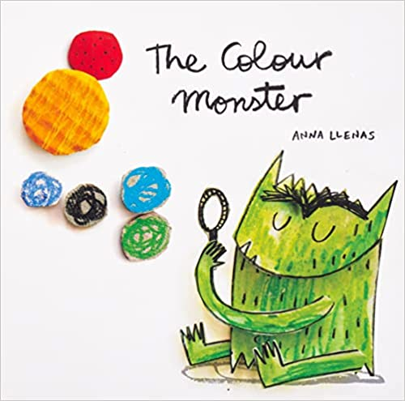
Wellbeing and the Colour monster
We are hoping that your children will come home and talk to you about The Colour Monster. The Colour Monster helps children to understand and express the confusing emotions that they sometimes feel through the use of colour.
Blue – sad and upset
Yellow – happy and cheerful
Green – calm and relaxed
Red – anger and frustration
Black – scared and anxious
Pink – love and affection
Mixed up – confused and unsure

Slide 17


Keeping in touch
Reception email address : reception@leighbeck-inf.essex.sch.uk
Leigh Beck Inf
Leigh Beck Infants - our open Facebook channel where we share school activities etc.
Leigh Beck Infant and Nursery Academy – closed information page for staff to
share information

Slide 18
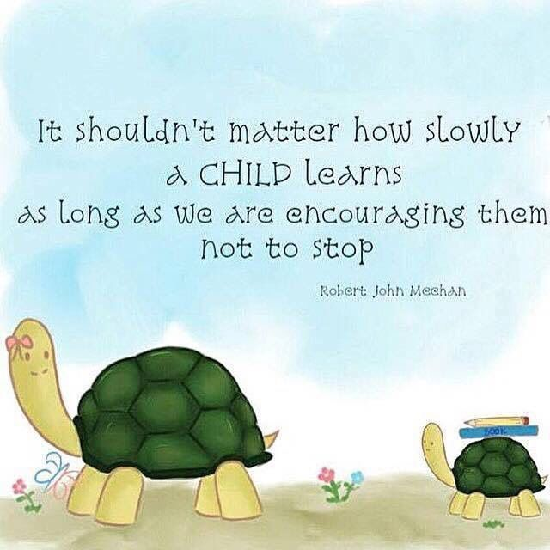
Thank you for coming and if you have any questions please ask…

